Slide 1
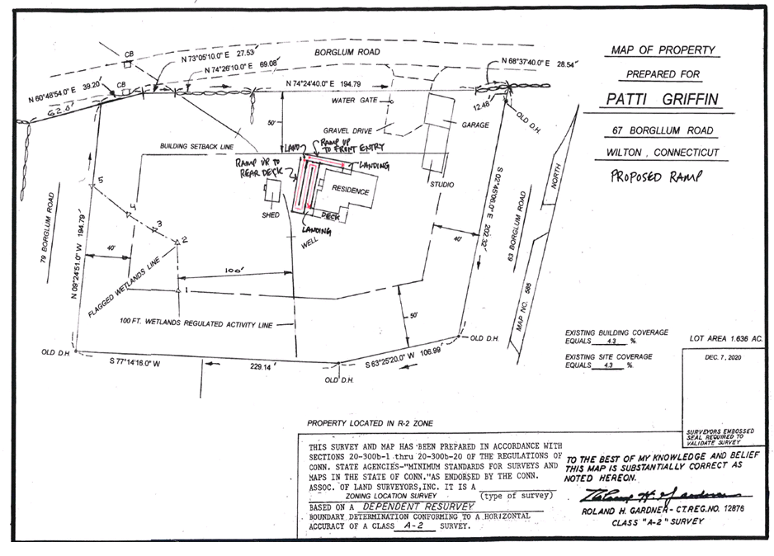
Proposed Handicap Temporary Ramp

Slide 2
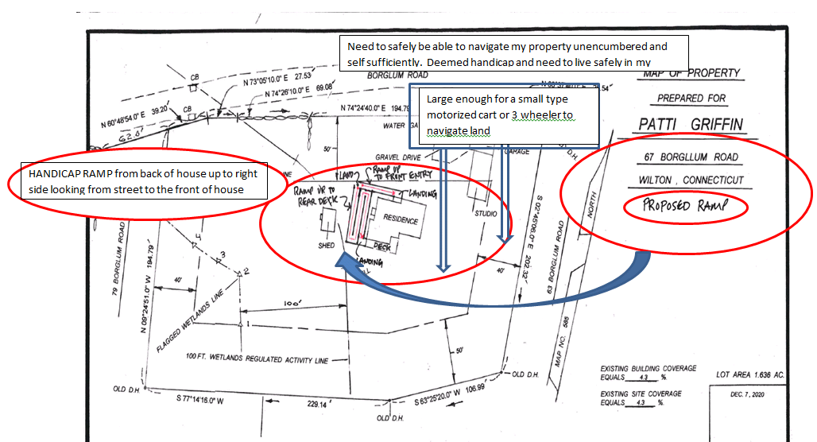
Proposed Handicap Temporary Ramp

Slide 3
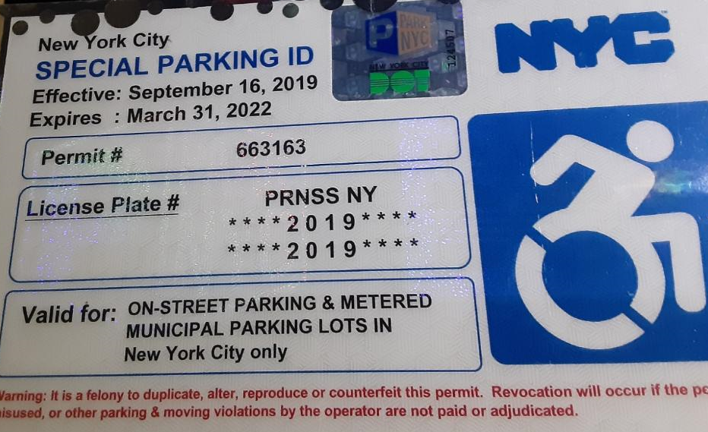

Slide 4
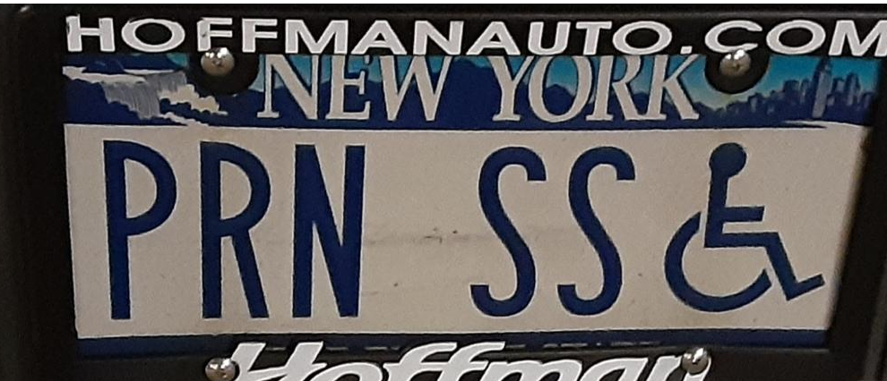

Slide 5
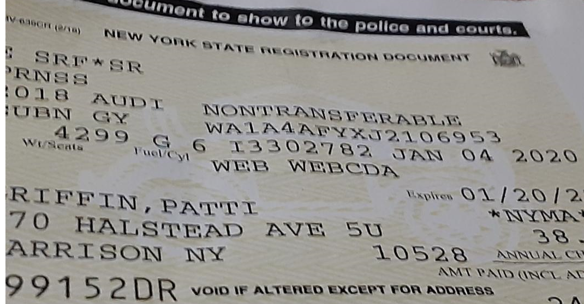

Slide 6
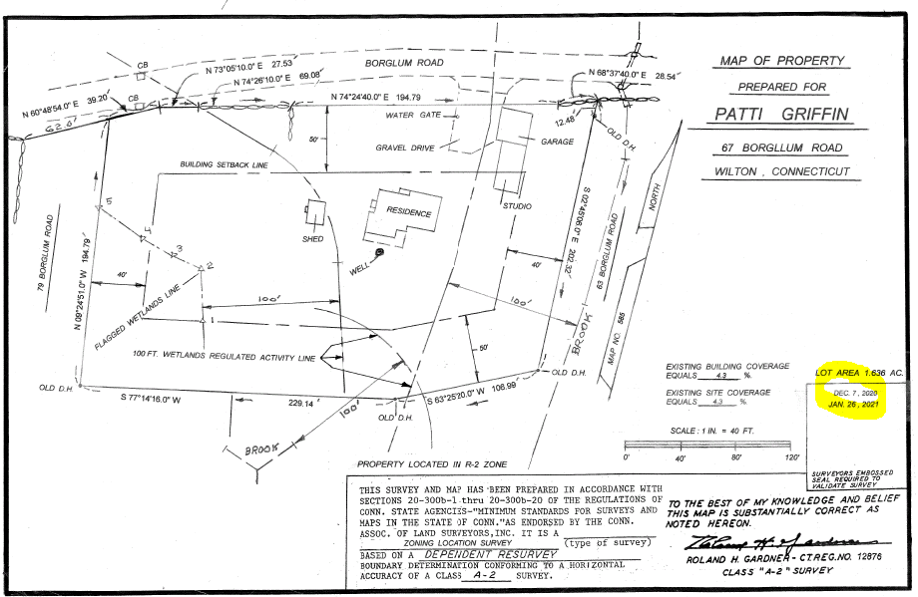
Updated as of 1/26/2021

Slide 7
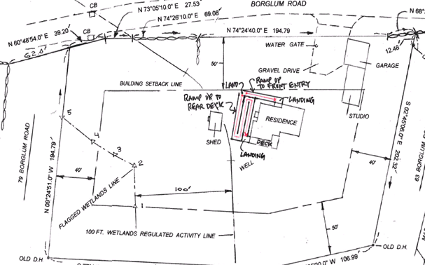
Tree replacement and placement with easy maintenance non shedding safe species

Slide 8
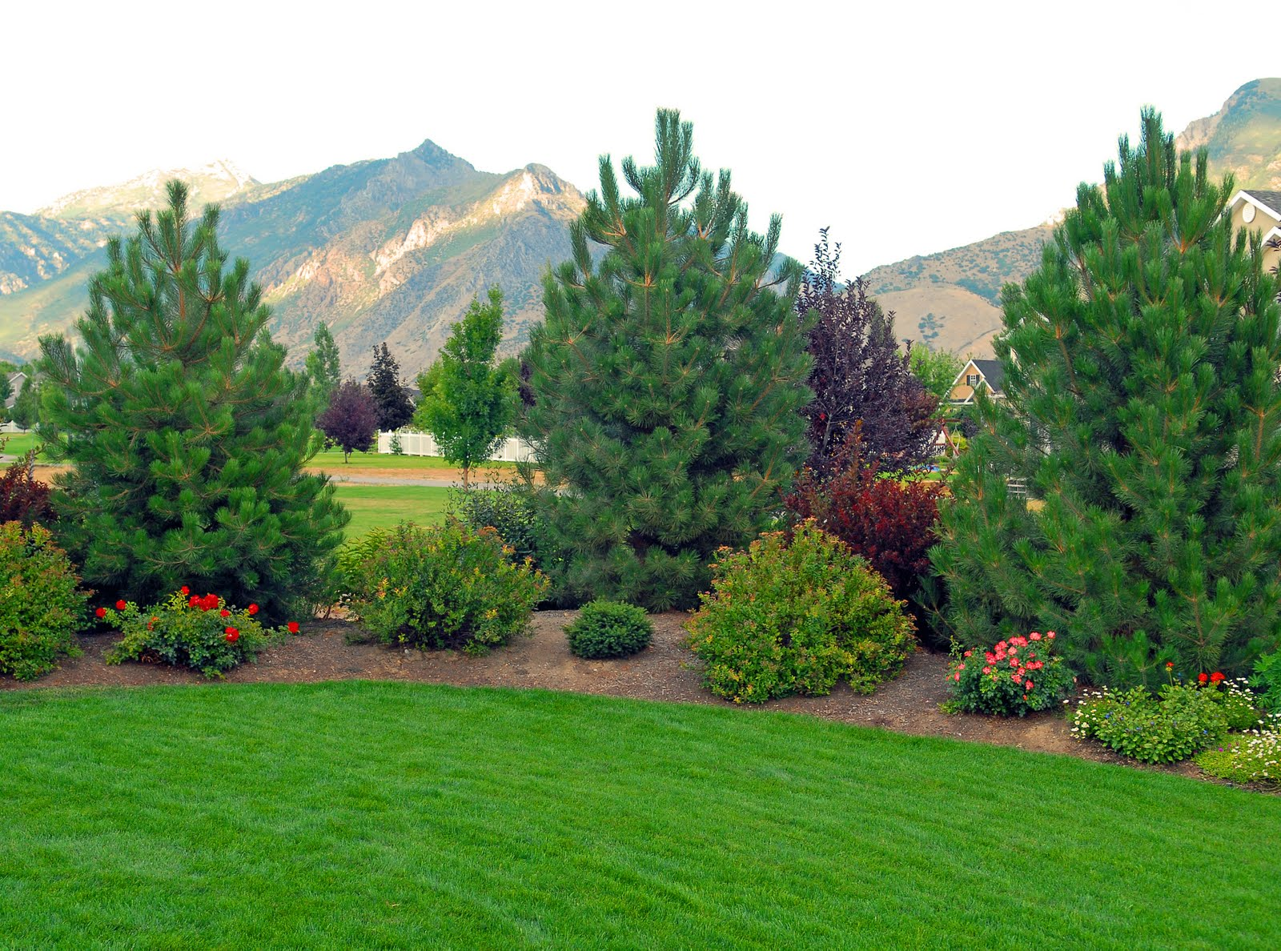

Slide 9
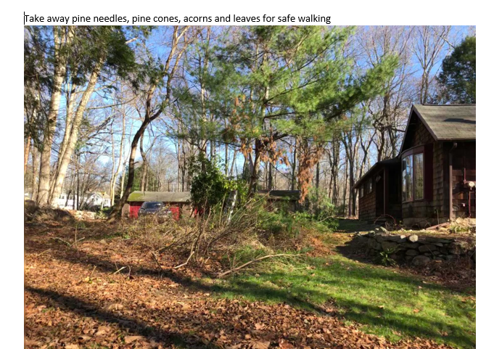

Slide 10
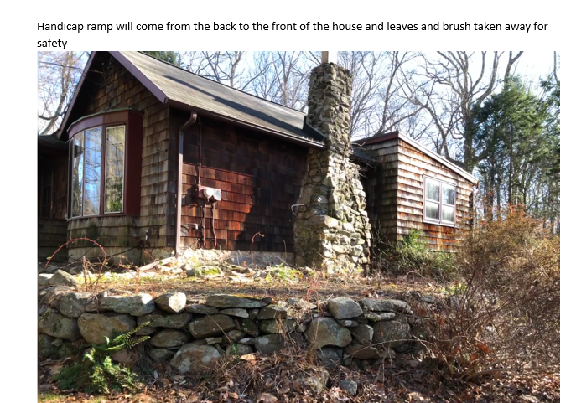

Slide 11
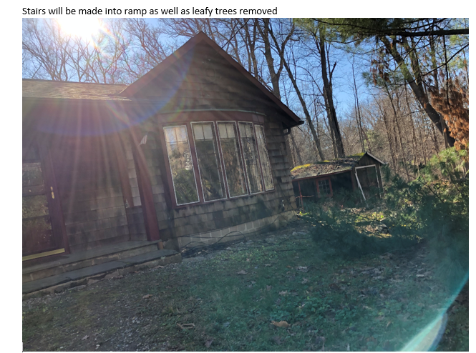

Slide 12
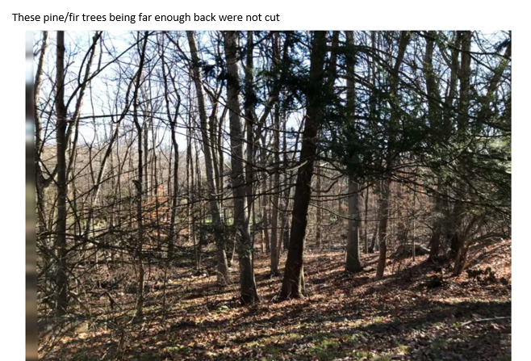

Slide 13
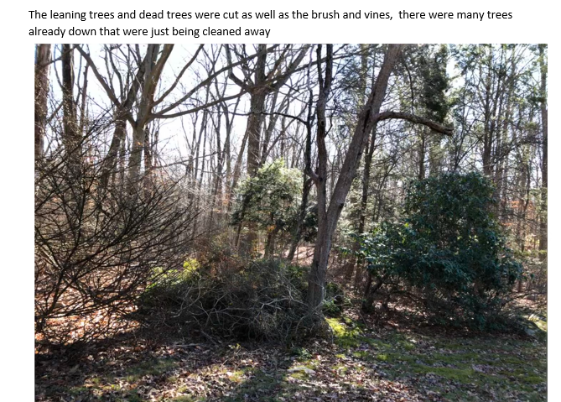

Slide 14
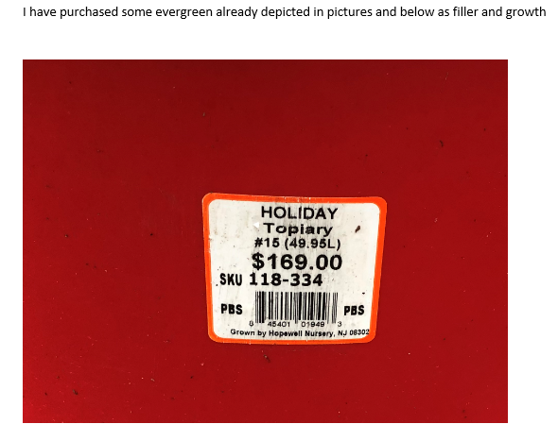

Slide 15
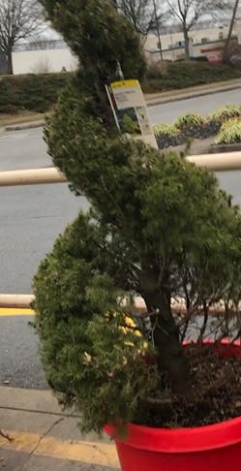

Slide 16
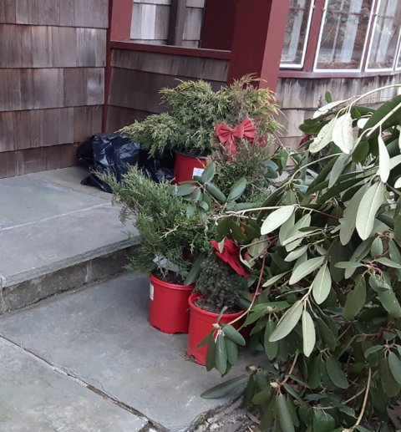

Slide 17
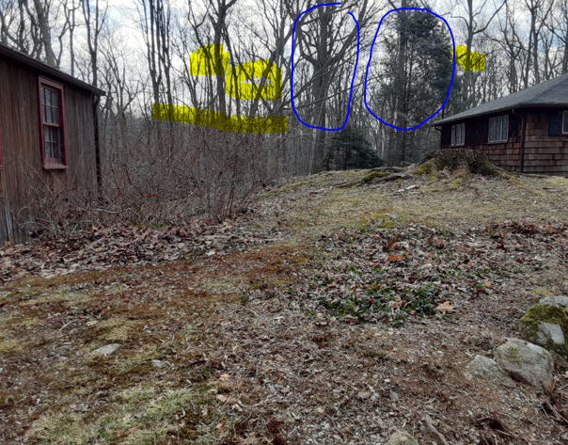
The ones in the circle remain the one leaning knocked on others and broke trunks

Slide 18
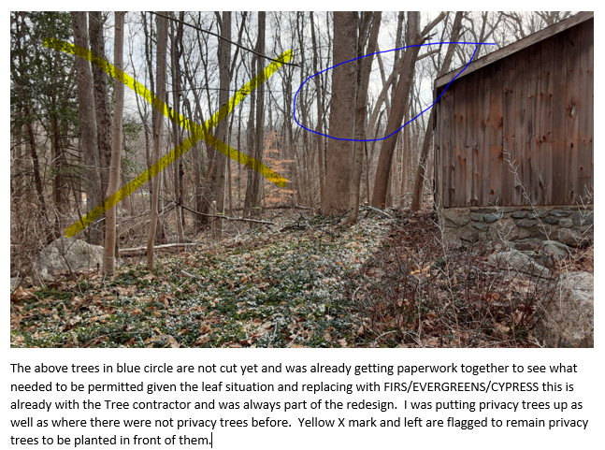

Slide 19
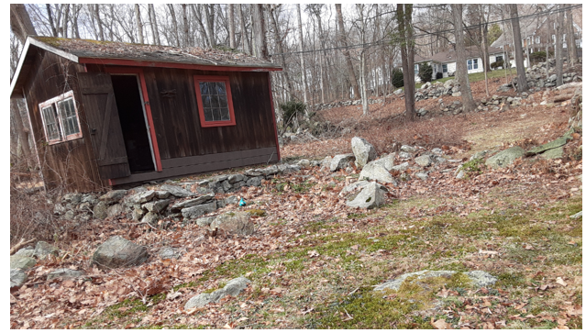
This structure on survey is well to right of property and will be retrofitted for a generator and whatever necessary repairs this permit is also being worked on. Privacy trees will also surround structure in the regulated fashion

Slide 20
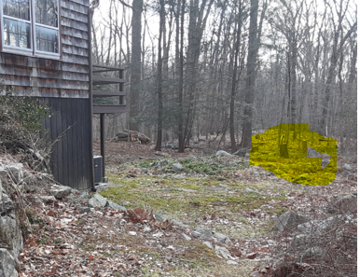
Trees that were down and cleaned up

Slide 21
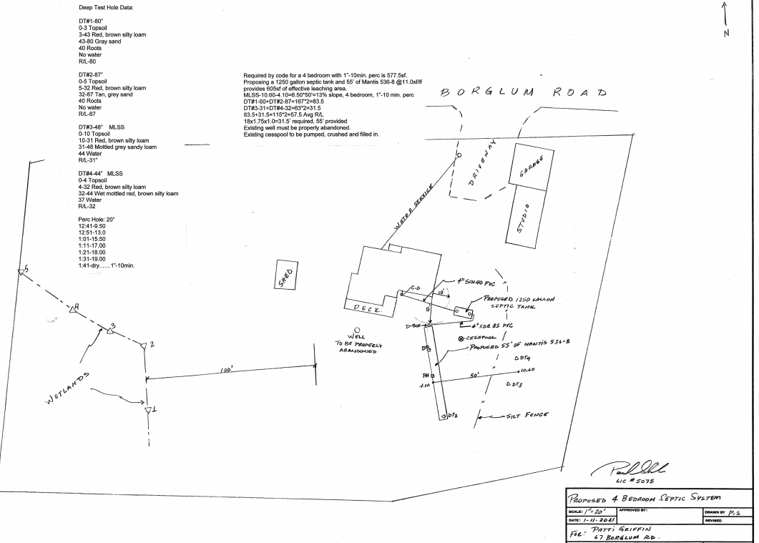
I am installing for resale value a 4 unit septic but as note I am not expanding the footprint today

