Slide 1
Wilton Center Master Plan- Review of Study Area
Zoning Regulations Subcommittee
January 20, 2021

Slide 2
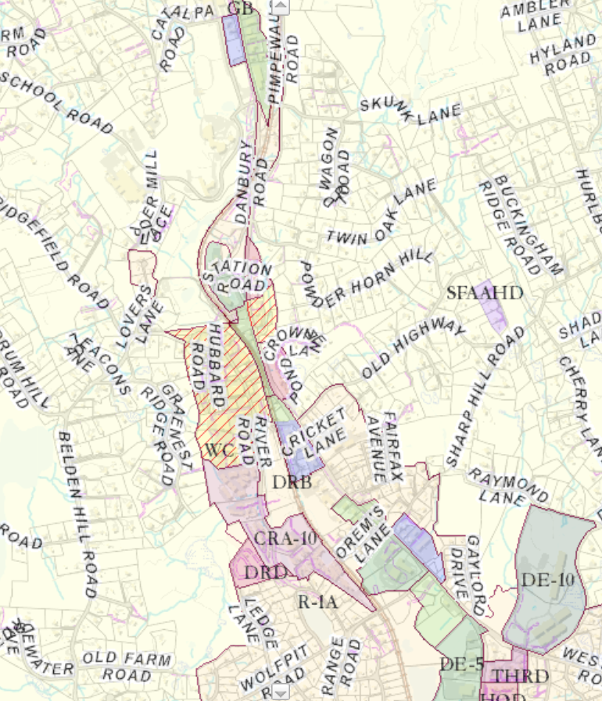
Overall Study Area – Wolfpit Road to School Road

Slide 3
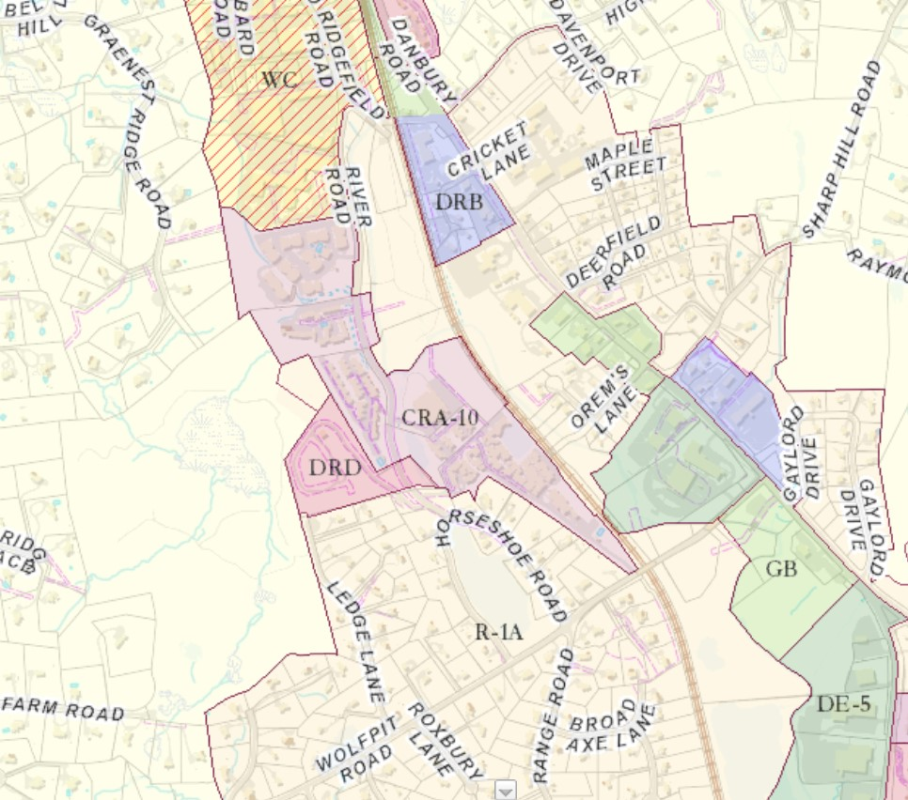
Wolfpit Road Zoning

Slide 4
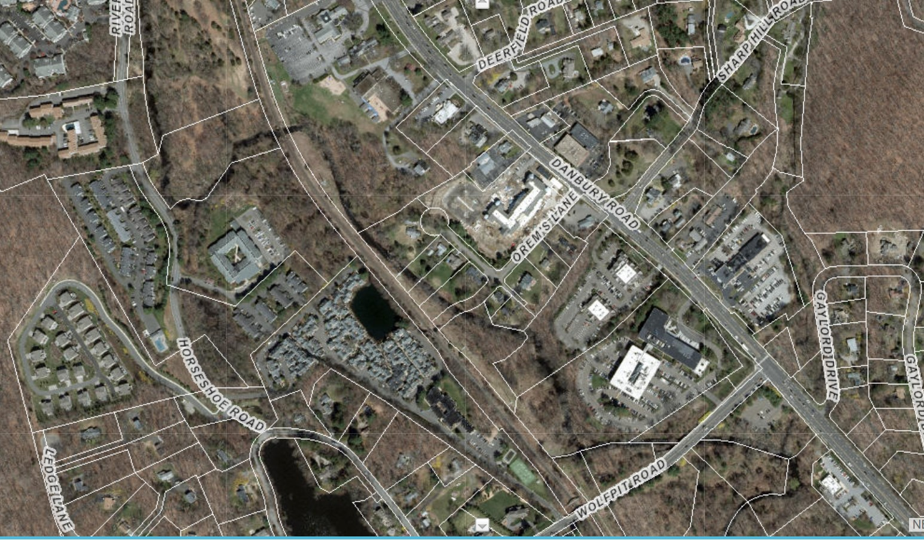
Wolfpit Road

Slide 5
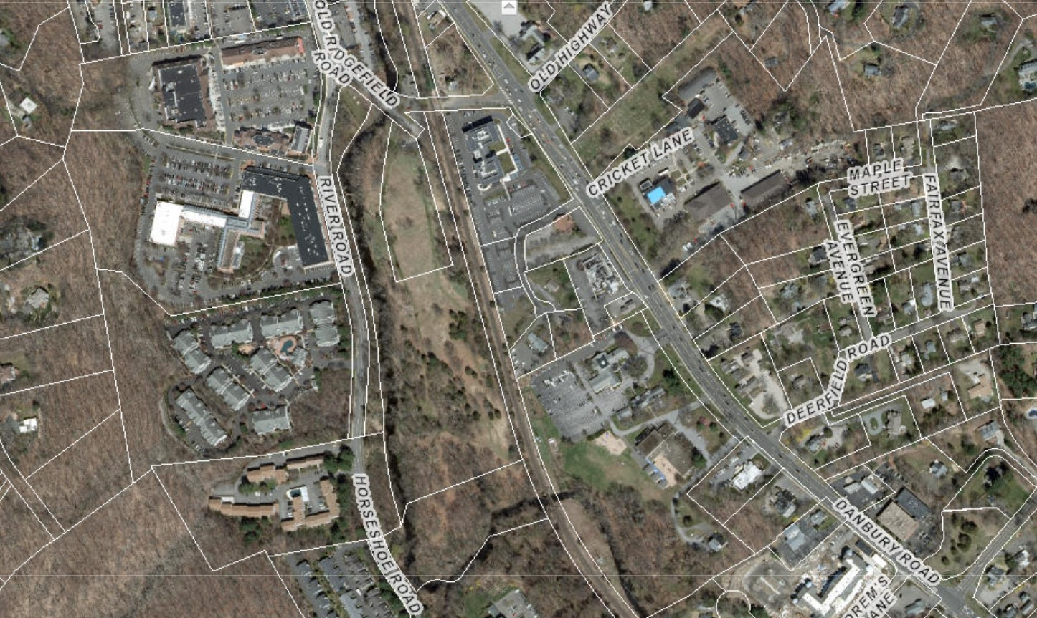
North of Wolfpit

Slide 6
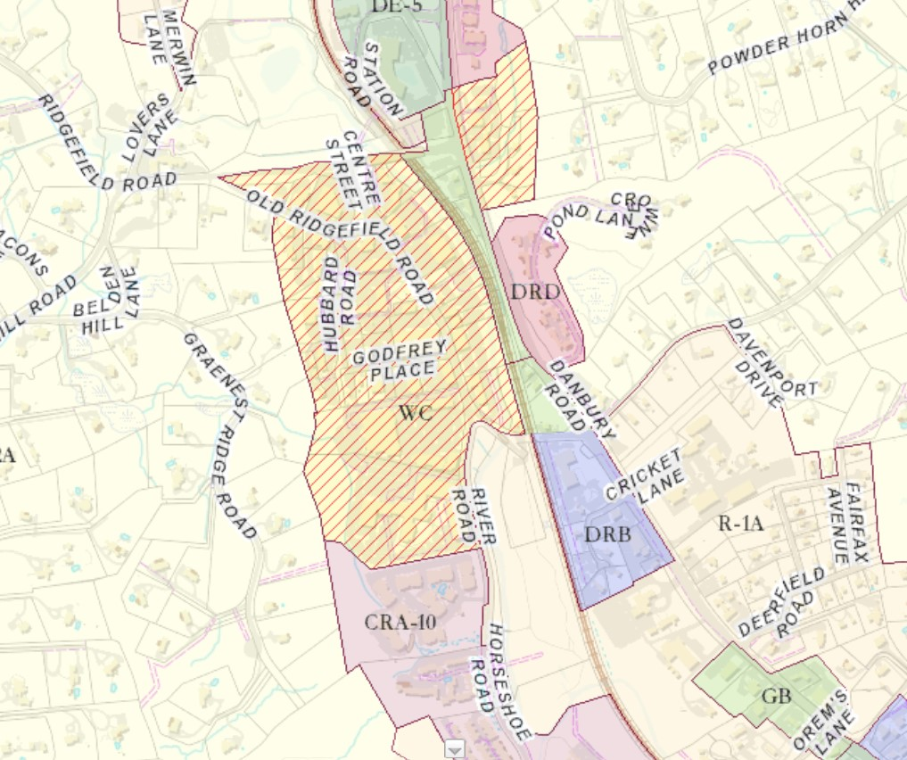
Wilton Center Zoning

Slide 7
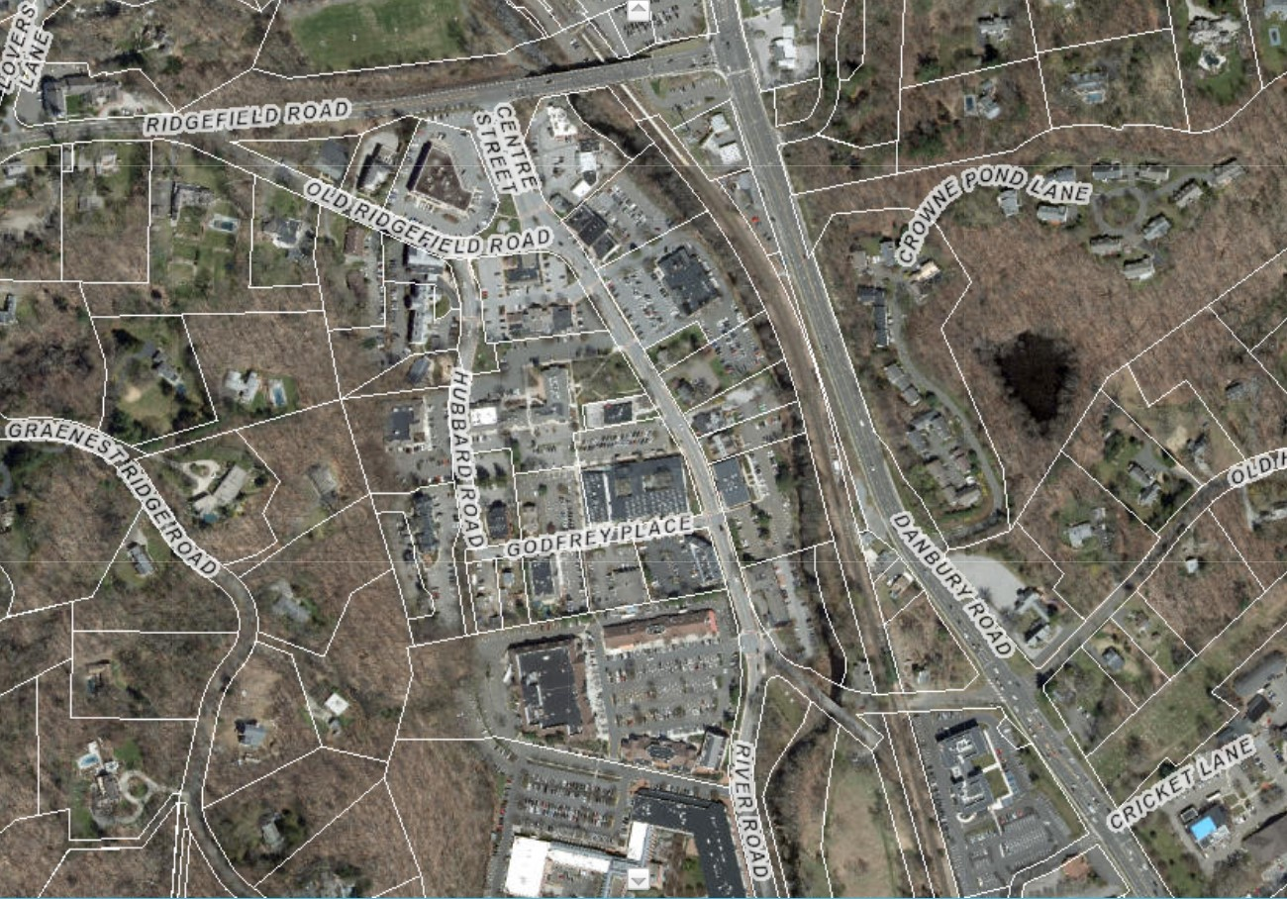
Wilton Center

Slide 8
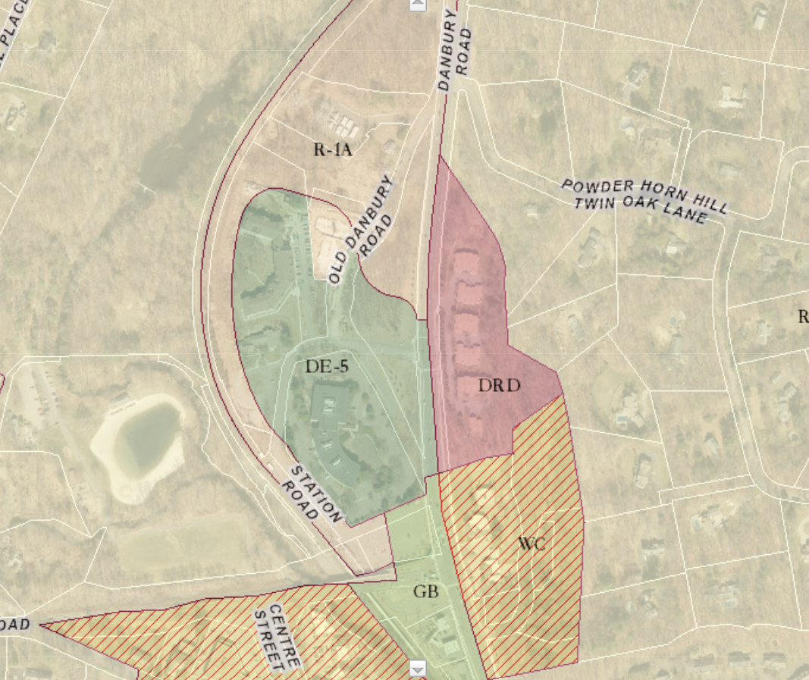
Station Road Zoning

Slide 9
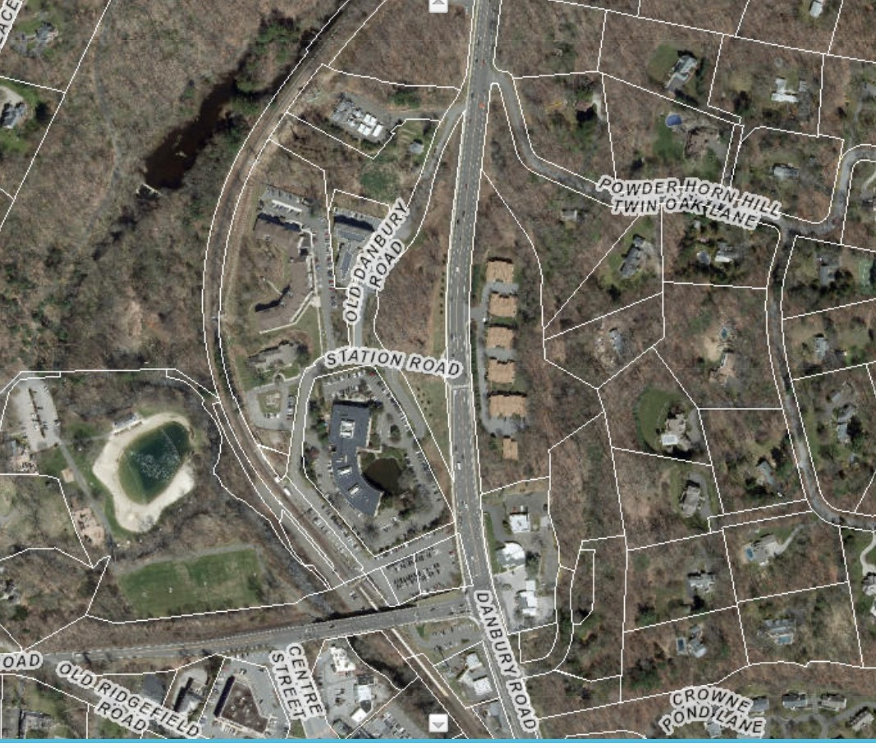
Station Road

Slide 10
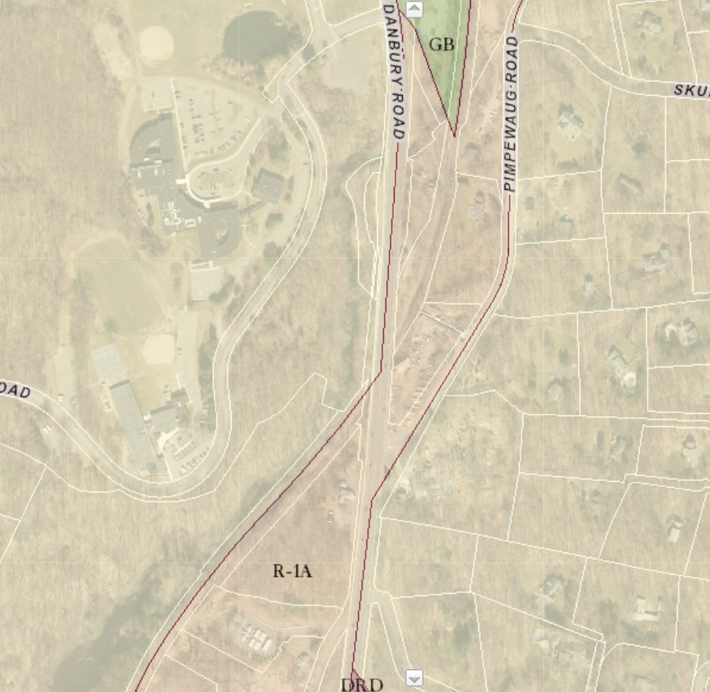
School Road Zoning

Slide 11
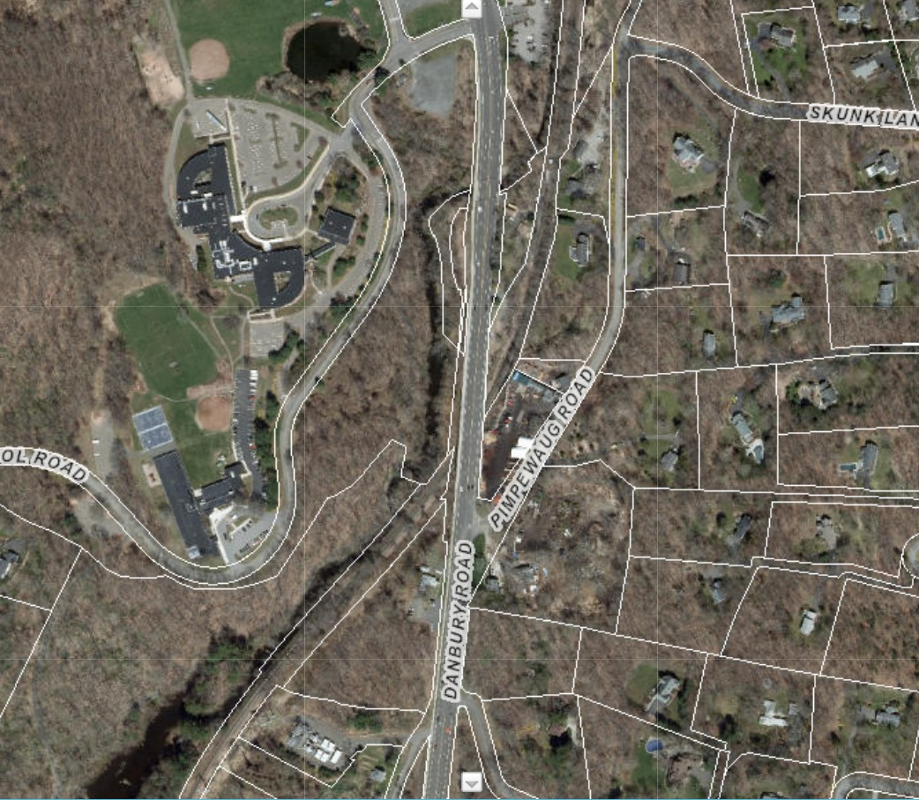
School Road

